Slide 1
Growth of firms

Slide 2
Learning Objective:
To be able to explain how firms grow in size
Learning Outcome:
Identify the factors that determine size of the firms
Explain how firms grow internally and externally
Explain different types of integration

Slide 3
https://youtu.be/eYEzU0B_Tjw

Slide 4
The sizes of firms can be measured in a number of ways:
Number of employees: The more the no.of workers employed, the larger the business is likely to be. But this is not true in many cases, especially in capital-intensive industries, where more capital is used than labourers (and the firm is still large)
Capital employed: this is the money invested in the business in productive assets (machinery, factory, stock of raw materials, money to pay wages etc) to produce goods and services and generate revenue. The more the capital employed in a firm, the larger their production will be and larger their size. However, labour intensive industries, where more labourer are used than capital can also be large.
Market share: Market share is the total market sales a firm is able to capture.The higher a firm’s market share, the larger the firm is likely to be. But, this depends on the size of the market itself. For example, a local salon will have a high market share, since the market is only a local town, but it is still a small business.
Organization: The internal organization- how the departments are organized- can tell a lot about it’s size. Large firms will have different specialized departments and people under them (purchasing, marketing, finance, production etc), while in a smaller business, the owners and employees share all the work among them.

Slide 7
GROWTH
Internal Growth/Organic Growth
This involves expanding the scale of production of it’s existing operations. This can be done by purchasing more machinery/equipment, opening more branches, selling new products into the market, expanding business premises, employing more workers etc.
External Growth
This involves two or more firms joining together to form a large business. This is called integration. This can be done it two ways: mergers or takeovers.
A takeover or acquisition happens when a company buys enough shares of another firms that they can take full control. This can happen without the owners’ agreement. The firm taken over loses it’s identity and become a part of what is known as the holding company. A well-known example would be Facebook’s acquisition of WhatsAapp in 2014. A merger occurs when the owners of two or more companies agree to join together to form a firm.

Slide 8
Integration can happen in three ways:
Horizontal Integration: integration of firms engaged in the production of the same type of good at the same level of production. Example: a cloth manufacturing company merges with/takes over another cloth manufacturing company.
Vertical Integration: integration of firms engaged in the production of the same type of good but at different levels of production (primary/secondary/tertiary). Example: a electronics manufacturing company merges with/takes over a electronic retail business. Forward vertical integration: when a firm integrates with a firm that is at a later stage of production than theirs. Example: a dairy farm integrates with a cheese manufacturing company. Backward vertical integration: when a firm when a firm integrates with a firm that is at an earlier stage of production than theirs. Example: a chocolates selling firm integrates with a chocolate manufacturing company.
Lateral/Conglomerate integration: occurs when firms producing different type of products integrates. They could be at the same or different sage of production. Example: a housing company integrates with a dairy farm. Thus, the firm can produce a wide range of products or diversify its range of products/risks

Slide 9
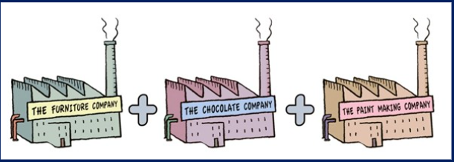
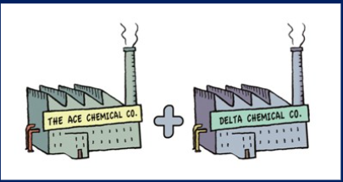
Identify different types of integration from the pictures given below

Slide 11
Learning Objective:
To be able to explain the impacts of firms growing too large
Learning Outcome:
Define economies and diseconomies of scale
Explain the different types of economies and diseconomies of scale
Draw economies and diseconomies of scale
Extension: Formulate link between impacts of firms growing too big with GC” identities and relationships”

Slide 13
Economies & Diseconomies of Scale
Economies of scale are the unit cost advantages from expanding the scale of production in the long run. LRAC decreases.
Diseconomies of scale are the cost disadvantages that firms accrue due to an increase in organizational size or output. LRAC increases

Slide 14
Internal economies of scale: LRAC is reduced as firms expand their scale of production.
Purchasing economies: Large firms can buy raw materials and components in bulk because of their large scale of production. Supplier will usually offer price discounts for bulk purchases, which will cut purchasing costs for the firm.
Marketing economies: Large firms can afford their own vehicles to distribute their products, which is much cheaper than hiring other firms to distribute them. Also, the costs of advertising is spread over a much large output in large firms when compared to small firms.
Financial economies: Banks are more willing to lend more money to large firms, since they are more financially secure (than small firms ) to repay loans. They are also likely to get lower rates of interest. Large firms (companies) also have the ability to sell shares to raise capital that do not have to be repaid. Thus, they get more money at lower costs.
Technical economies: Large firms are more financially able to invest in good technology, machinery etc which are very efficient and cut costs for the firm.
Managerial Economies: Where in a firm are able to hire specialists which devise strategies to reduce costs in the long run.
Risk-bearing economies: Large firms with a high output can sell into different markets (even overseas). They are able to produce a variety of products (diversification in production). This means that their risks are spread over a wider range of products or markets; even if a market or product is not successful, they have other products and markets to continue business. Thus, costs are reduced.

Slide 15
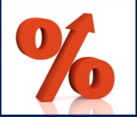
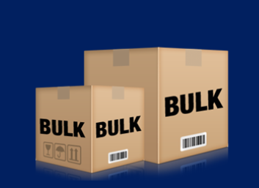
Identify different internal economies of scale from the pictures

Slide 16
Diseconomies of scale
They occur when a firms grows too large and average costs start to rise. Some common diseconomies are:
Management diseconomies: Large firms have a wide internal organization with lots of managers and employees. This makes communication difficult and decision-making very slow. Gradually, it leads to inefficient managerial running of the firms and increases costs.
Too much output may require a large supply of raw materials, power etc. which can lead to shortage and halt production, increasing costs.
Labour Diseconomies : Large firms may use automated production with lots of capital equipment. Worker operating these machines may feel bored in doing the repetitive tasks, and thus demotivated and less cooperative. Many workers may leave or others could go on strikes, stopping production and increasing costs.
Agglomeration diseconomies: this occurs when firms merge/acquire too many different firms producing different products, and the managers and owners can’t coordinate and organize all activities, leading to higher costs.
More shares sold into the market and bought means more owners coming into the business. Having a lot of owners can lead to a lot of disputes and conflicts among themselves.
A lot of large firms can face diseconomies when their products become too standardized and less of a variety in the market. This will reduce sales and profits and increase average costs.

Slide 18
Why do some firms remain small?
The size of their market is small: Business like hairdressers, restaurants, cafés, hotels that provide personalized goods and services, can only supply to a small market.
Access to capital is limited, so owners can’t grow the firm.
New Technology
Owner(s) prefer to stay small: A lot of entrepreneurs don’t want to take risks by growing the firm and they are quite satisfied with running a small business.

Slide 19
External Economies of Scale

